Slide 1

Project V:
FEM Calculation of Warping (Saint-Venant Torsion)
*I switched to the other slides*
Andy Nguyen
Brian Tam
Chris Chin
Jannette Choi
Matthew Yeung
Sam Liu
Celina Shaw
Sean Yen

Slide 2
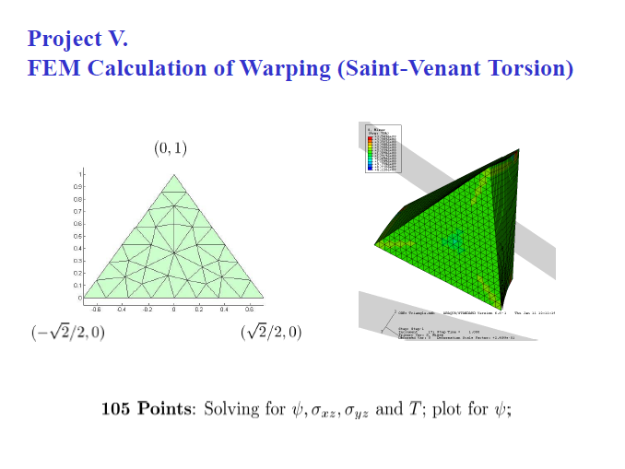

Slide 3
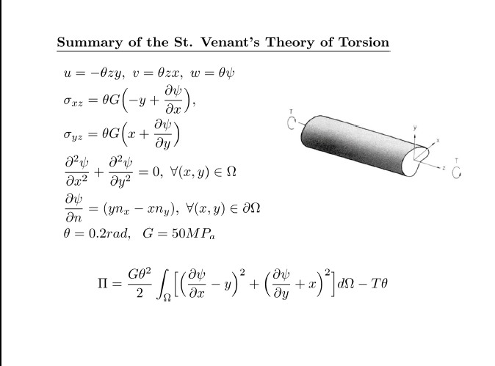

Slide 4
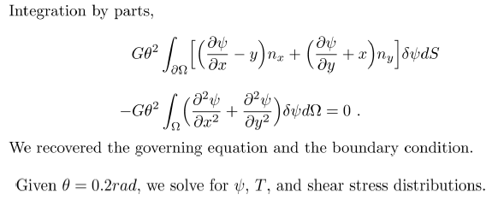

Slide 5
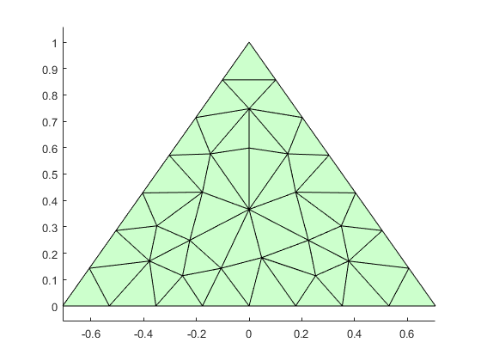
Boundary node Matrix
16
e 17 15
18 14
19 13
20 12
21 11
22 10
1 2 3 4 5 6 7 8 9

Slide 6
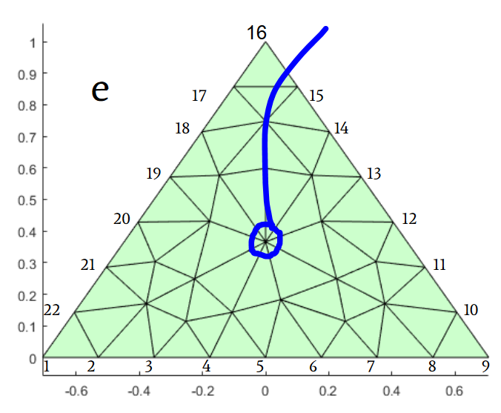
Node 23 - This point remains fixed. Doesn’t displace due to torsion.

Slide 7
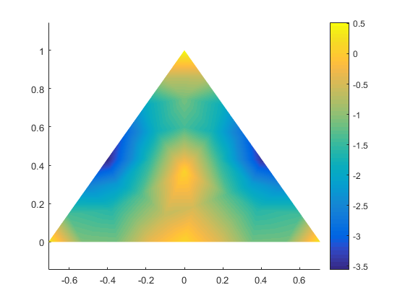

Slide 8
